Slide 1
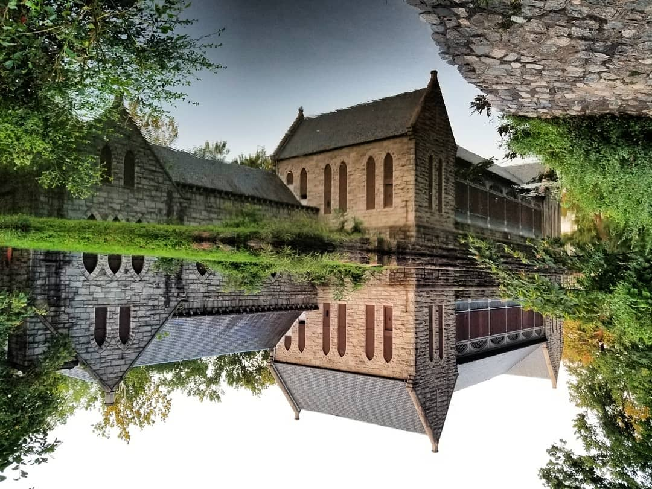

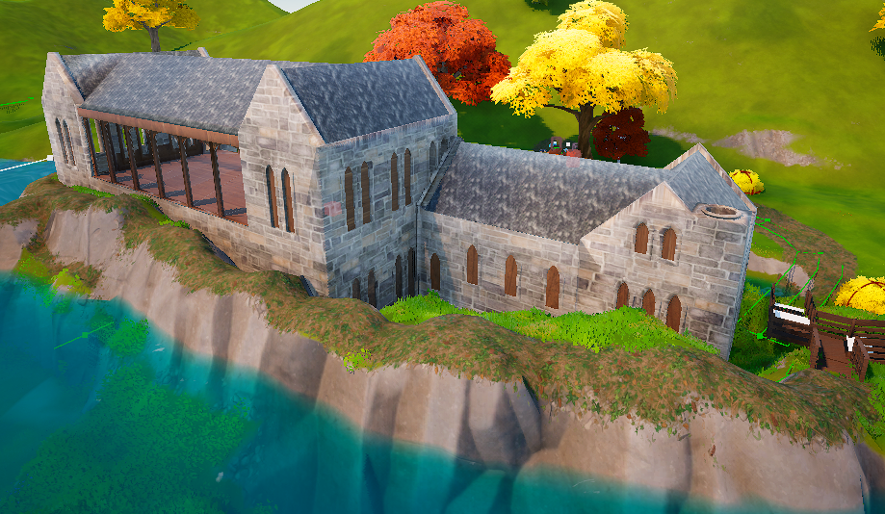

25-306
VCU-CodeRVA Coding Partnership
Team members: Kibria Malik, Ken Mikawa, Bryce Strobel, Kel Raphael | Faculty adviser: John Leonard Ph.D. | Sponsor: CodeRVA | Mentor: John Leonard Ph.D.
Primary Objective
Method
Final Result
Our first step was visiting the pumphouse, to research the island and gather data. Using Unreal Editor for Fortnite (UEFN), we created a basic concept of what we wanted the island to look like, and then passed it over to our partners at CodeRVA.
CodeRVA, a speciality high school in Richmond, allowed us to work with two sets of seniors who took our ideas and research and made the second iteration of the island over the course of two semesters.
Finally, after the CodeRVA students handed the reins of the project back to us, we spent the remaining months fine tuning the project with updated graphics, bug fixes, and additional features.
The Richmond Pump House, once a historic structure used to supply Richmond with drinking water, has been in a state of disrepair since its closure in 1924. For almost a century it lay in that state, until Joseph Costello founded the Friends of the Pump House, an organization dedicated to restoring the Pump House to its former glory.
However, restoring the Pump House doesn’t come cheap. Even though they have received plenty of funding, the Friends of the Pump House will need plenty more if their goals of reopening the Pump House as a social gathering hub and museum are to be realized.
To help them achieve this goal, we created a Fortnite Experience recreation of The Richmond Pump House.
Most of our work has focused on the Pump House, the nearby land and river, and the bridges and stairs leading up to the Pump House.
Additionally, we have added features to make the island experience more engaging:
HUD popups when users enter or leave defined sections
In-game billboards display real life images of the Pump House
Users can gather collectibles to earn rewards
NPCs that tell users interesting facts about the Pump House and Pump House Park
A parkour course to challenge users
Fishing spots
The Richmond Pump House is a beautiful place, with a history deeply connected to Richmond. We hope you enjoy your exploration.
Key design details
In order to create an experience that will draw attention of young adults to the Richmond Pump House, we decided that the following are key design details to include:
Accurate Architectural Recreation: The Richmond Pump House and its surrounding environment are faithfully reconstructed using historical references in UEFN.
Engaging Player Experience: The map is designed to be interactive with elements such as HUD pop-ups, NPC dialogue, and collectibles.

